Slide 1

IoT Edge Session
Pied Piper Program
2nd August 2017
Alberto Ramos
@AlbertoSyd

Slide 2

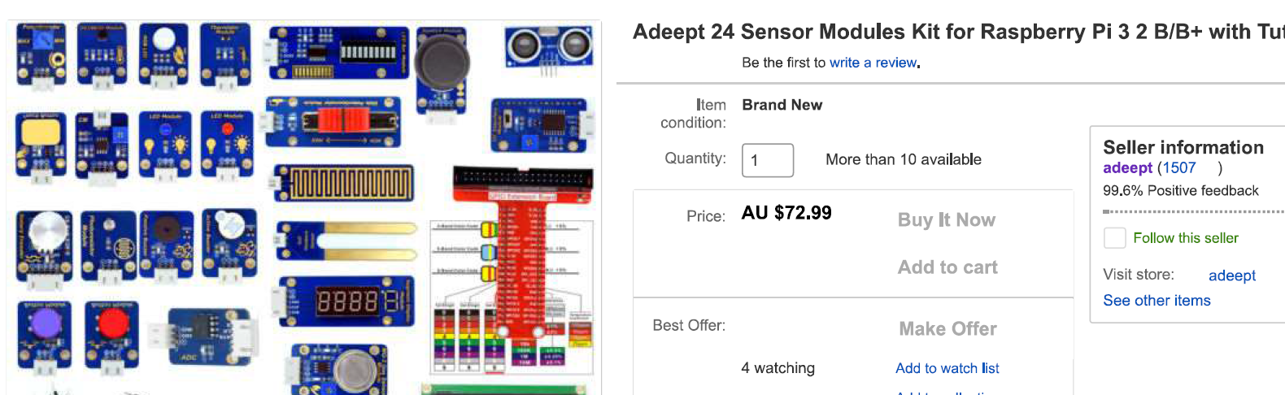
Prerequisites
Raspberry Pi 3 B with 16GB SD card (Raspbian Jessie)
Follow the Raspberry Pi setup procedure
Install Virtualbox and Vagrant
Notes:
Mention the Digital and IT Transformation: Modernize, AUTOMATE, Transform

Slide 3
Agenda
IoT Concepts
Sensors and Actuators
External Communications
From Prototyping to Final Product
Notes:
Mention the Digital and IT Transformation: Modernize, AUTOMATE, Transform

Slide 4
Fast Forward into the Future
https://www.youtube.com/watch?v=OFzSa8oW5WA

Slide 5
IoT Concepts

Slide 6
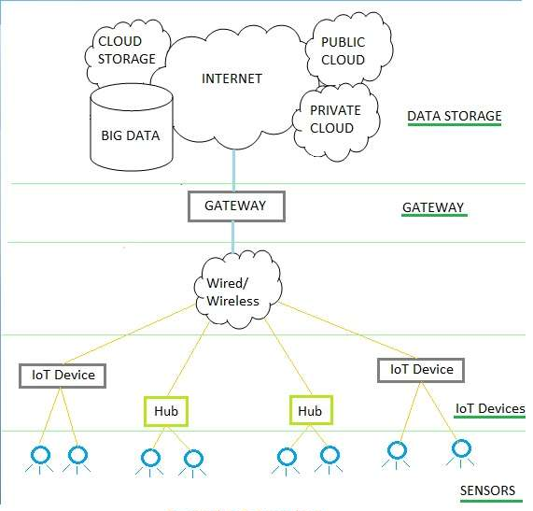
IoT Concepts
Sensors
Inputs into the system
Actuators
Outputs of the system
IOT Device (Microcontroller)
Sensors/actuators don’t work by alone
Gateway
Aggregates, analyses, cleanses data
Real-time decision making
Sends meaningful data. Lower transfer cost

Slide 7
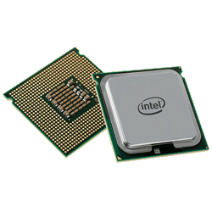
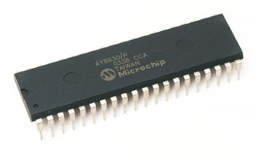
CPU vs MCU vs FPGA
Microprocessor
Contains only CPU. Relies on external peripherals: ROM, RAM, disks …
Deal with Complex tasks. General purpose
Intel, AMD, Qualcomm, Broadcom, NVDIA, IBM, … X86, ARM architectures
Microcontroller
Contain processor (single core), RAM, ROM and I/O pins in the chip. No OS
Used in embedded systems. Compact format. Cheaper
Firmware (vs OS). Deal with specialised tasks
Texas Instruments, Microchip, … Atmel, Espressif
FPGA (Field Programmable Gate Arrays)
Use HDL (Hardware Description Language) to configure internal circuitry
Notes:
Microcontrollers run their code from ROM whereas Microprocessors run only the boot code from ROM. Then they load the code in RAM during the boot process and run it from there.

Slide 8
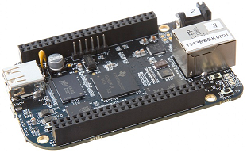
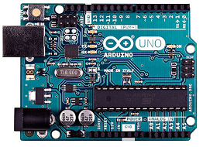
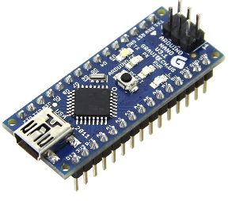
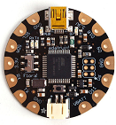
SBC vs Development Board
Single Board Computer
Full-blown computer with everything required on the board
Lower specifications than full scale computers
Raspberry PI, Beaglebone Black, C.H.I.P, Intel Edison, Orange PI, Banana PI
Development Board
Contains microcontroller, power supply, crystal, female headers, USB, …
Typically used for prototyping
Arduinos, NodeMCU, Photon, Teensy, Feather, Lilypad …
Often can be programmed through an IDE, ex: Arduino IDE
Notes:
http://makezine.com/comparison/boards/

Slide 9
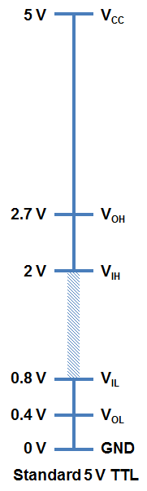
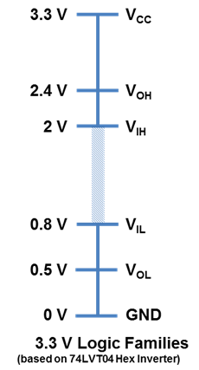
Elements of Microcontrollers
CPU (ex: Atmega328P 8-bit in Arduino)
Clock (8MHz – 50MHz as opposed to GHz)
RAM, ROM, Flash memory - Usually in the KB range
Logic Level – 5V vs 3.3V
Digital ports – 0 or 1
Analog ports
ADC
Resolution depends on internal ADC, ex: 10bit = 0-1023
Notes:
https://store.arduino.cc/usa/arduino-uno-rev3
https://learn.sparkfun.com/tutorials/logic-levels
https://learn.sparkfun.com/tutorials/analog-to-digital-conversion

Slide 10
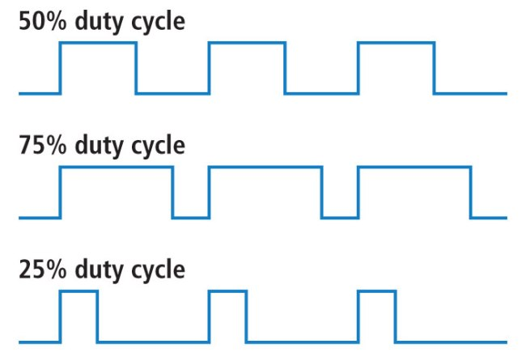
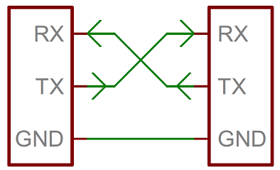
Elements of Microcontrollers
PWM – Pulse Wave Modulation
Use digital signal to represent analog
Frequency is important for each application
Typically deal with it through a library
Ex: Dimming LEDs, Servo angle, Motor speed
Serial
No clock = Async = Baud rate, data bits, sync bits …
Half/Full Duplex, Simplex (ex: LCD)
Managed by UART chip, typically inside the MCU
Used with Bluetooth, GPS … flashing firmware, serial monitor
Careful not to connect more than 1 device at once
Interrupts
Interrupt Service Routine gets attached to a pin
When triggered, the processor saves execution state, runs ISR and resumes
Notes:
https://learn.sparkfun.com/tutorials/pulse-width-modulation
https://learn.sparkfun.com/tutorials/serial-communication/serial-intro
If a microcontroller doesn’t have a UART (or doesn’t have enough), the serial interface can be bit-banged - directly controlled by the processor. This is the approach Arduino libraries like SoftwareSerial take. Bit-banging is processor-intensive, and not usually as precise as a UART, but it works in a pinch!
https://www.arduino.cc/en/Reference/SoftwareSerial

Slide 11
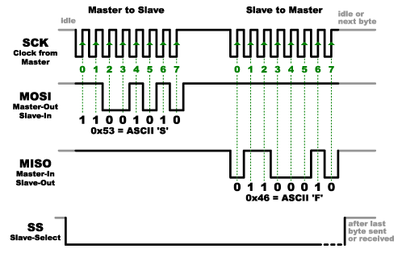
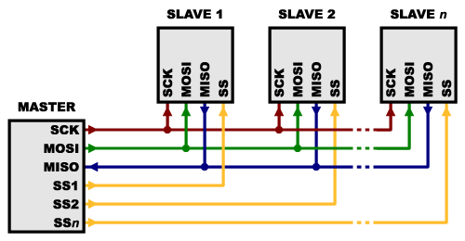
Elements of Microcontrollers
SPI (Serial Peripheral Interface)
One master (typically MCU) to multiple slaves
Programmed through a library
Pros
Synchronous. Clock signal from the Master
Faster, ex: 10 Mbits/sec
Simpler. Cheaper hardware
No baud rate mismatches. No extra bits overhead
Cons
4 Pin required (SCK, MOSI, MISO, SS= Slave Select)
1 additional SS Pin for each new slave
Can share one pin if only output required, ex: LEDs
Notes:
https://learn.sparkfun.com/tutorials/i2c
https://learn.sparkfun.com/tutorials/serial-peripheral-interface-spi
https://learn.sparkfun.com/tutorials/raspberry-pi-spi-and-i2c-tutorial

Slide 12
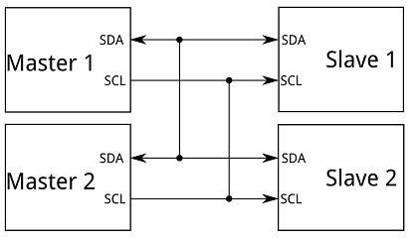
Elements of Microcontrollers
I²C (Inter Integrated Circuit)
Multiple slave IC’s communicate with one or more Master IC’s
Up to 1008 slave devices
Simpler hardware than Serial
Commonly up to 400KHz
Requires 2 pins: SDA and SCL
Notes:
https://learn.sparkfun.com/tutorials/i2c
https://learn.sparkfun.com/tutorials/serial-peripheral-interface-spi
https://learn.sparkfun.com/tutorials/raspberry-pi-spi-and-i2c-tutorial

Slide 13
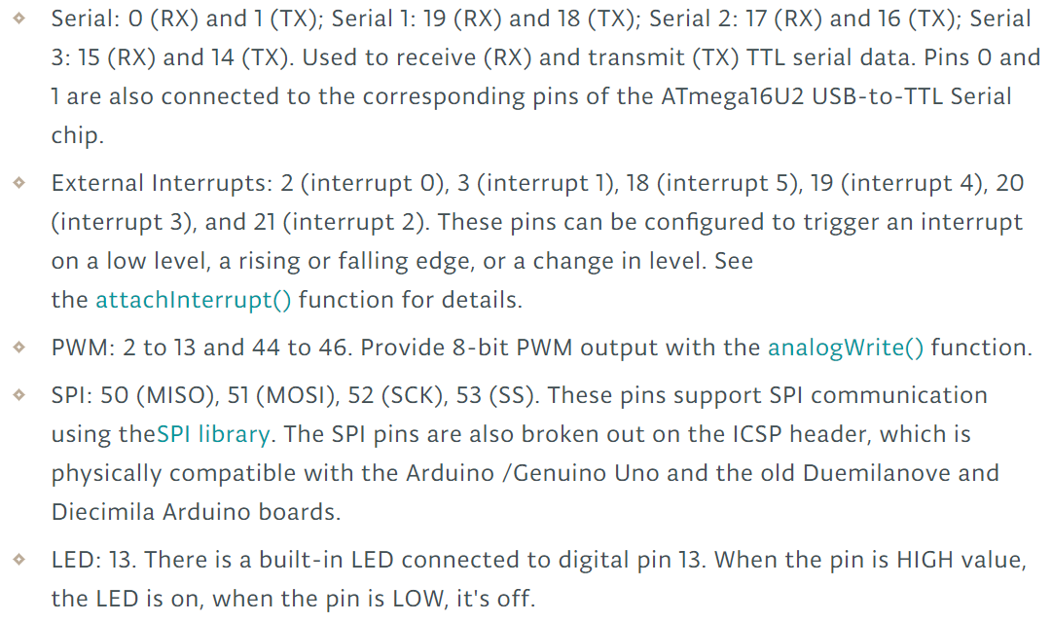
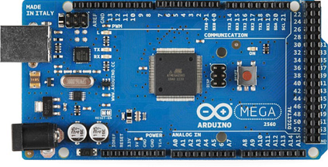
Sample Microcontroller Specs – Arduino Mega
Notes:
https://store.arduino.cc/usa/arduino-mega-2560-rev3

Slide 14
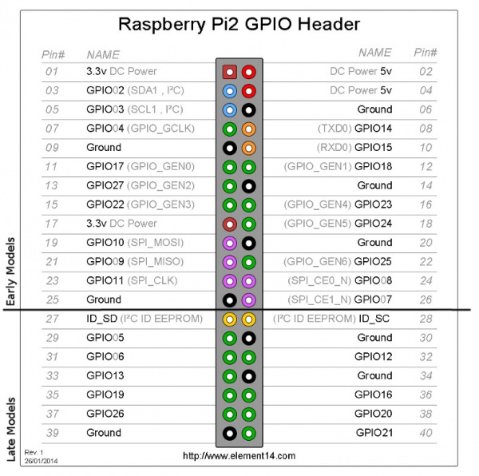
Raspberry PI GPIO
General Purpose Input/Output
3.3V logic level. No 5V tolerant
26 digital pins. No analog
Can reconfigure almost all GPIO pins:
SPI, PWM, I²C, Interrupt
Code in many languages
Python - RPi.GPIO module:
Installed in Raspbian by default
Scripts must be run as root
Also available for Python:
Pigpio (daemon, 32 PWM pins)
RPIO
WiringPi2-Python
gpiozero
Notes:
https://learn.sparkfun.com/tutorials/raspberry-gpio/gpio-pinout
http://elinux.org/RPi_GPIO_Code_Samples (C#, Python, Ruby, Perl, Basic, Shell, Java, Scratch, Pascal, …)
http://elinux.org/RPi_Low-level_peripherals
http://elinux.org/RPi_BCM2835_GPIOs

Slide 15
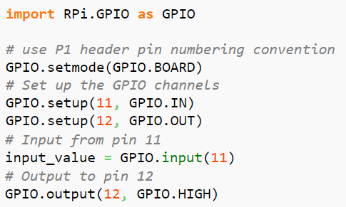
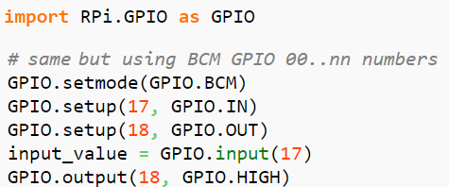
Raspberry PI GPIO
Many PIN numbering conventions
Physical numbering
GPIO numbering
Notes:
https://learn.sparkfun.com/tutorials/raspberry-gpio/gpio-pinout
http://abyz.co.uk/rpi/pigpio/python.html
https://learn.sparkfun.com/tutorials/raspberry-pi-spi-and-i2c-tutorial

Slide 16
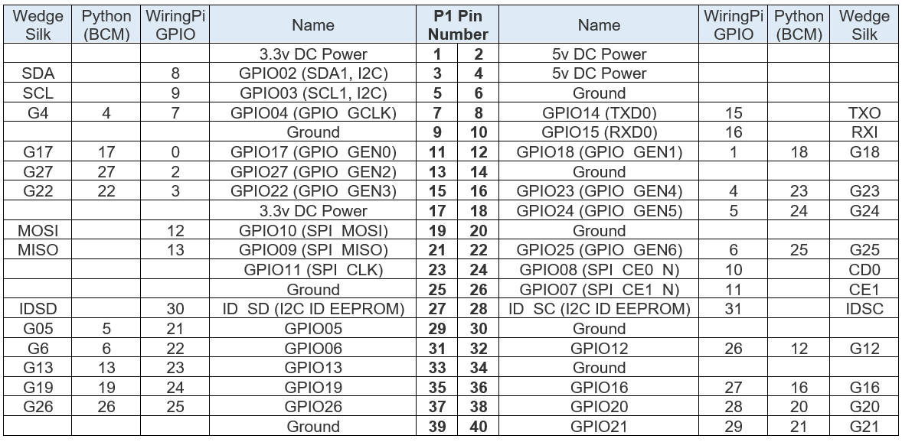
Raspberry PI GPIO
To complete ??????
Notes:
https://learn.sparkfun.com/tutorials/raspberry-gpio/gpio-pinout
https://www.raspberrypi.org/documentation/hardware/raspberrypi/README.md
https://learn.sparkfun.com/tutorials/raspberry-pi-spi-and-i2c-tutorial

Slide 17
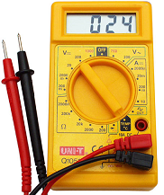
Basic Electricity
Ohm’s Law
Multimeter
Electricity flows from High Voltage to Low Voltage
from VCC to GND

Slide 18
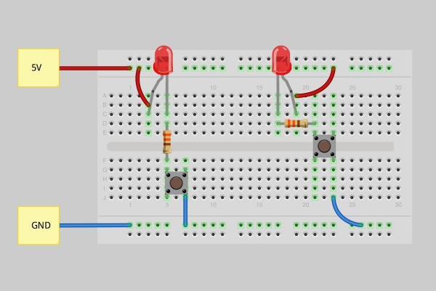
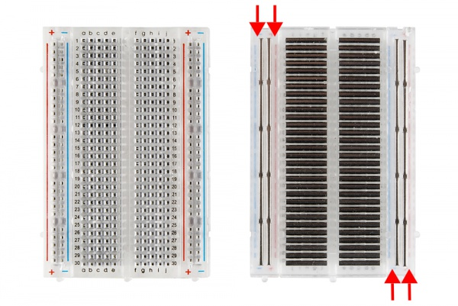
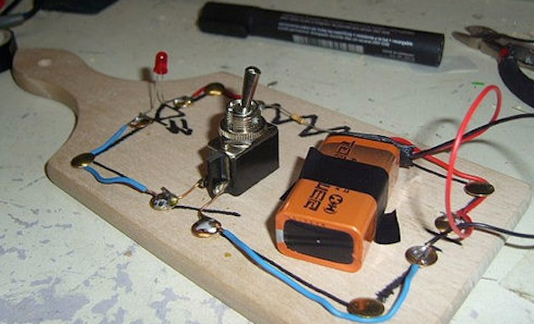
Breadboard

Slide 19
Lab 1: IoT Hello World

Slide 20
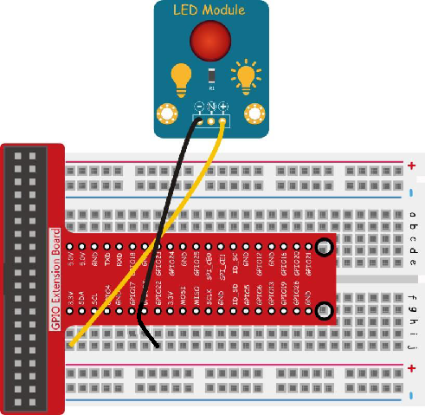
Blink an LED
Clone repo:
https://github.com/cermegno/iot-rpi
Patch the Raspberry Pi as follows:
- 15
+ 1
N unpatched

Slide 21
Blink an LED
Examine “led1.py” script with IDLE. Run it by pressing F5
This works … but it is not best practice
Use variables at the top to define what each pins function is
Follow in Python the same structure as with MCU’s
Detect CTRL-C and execute GPIO.cleanup() on exit
Examine “led2.py” and run it
Exercise: Can you get it to do 5 fast flashes and a pause?

Slide 22
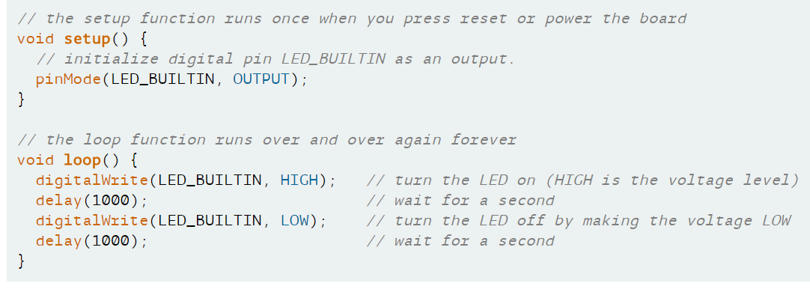
Blink an LED – the Arduino way

Slide 23
Sensors and Actuators

Slide 24
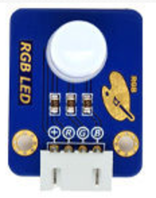
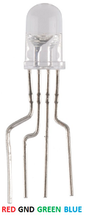
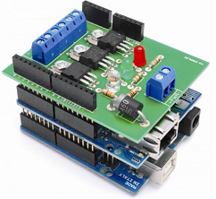
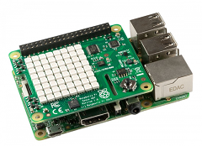
Sensors vs Shields or HATs
Sensors/Actuators can be packaged:
By themselves
On a small board along with any components required, ex: resistors
Included into a board that can be stacked atop Arduino, Raspberry PI
Arduino Shields
RPi HAT (Hardware Added on Top)

Slide 25
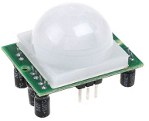
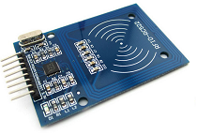
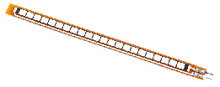
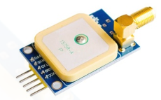
Sensor examples
Basics: LED, Strip, Displays, Buttons, Potentiometer, Buzzer, Joystick
Environmental: Temperature, Humidity, Brightness, UV, Colour, Barometric, Hygrometer, Sound/Noise, Liquid Level, Liquid Flow, Geiger
Gas: CO2, CO, Methane, Propane, Ethanol …
Motion: Accelerometer, Magnetometer, Hall Effect, Motion, Flex, Force, Ultrasonic, Vibration, Laser or IR Tripwire, GPS, Lidar
DC Motor, Servo, Stepper Motor, Relay, Linear Actuator
SD Card, RFID, Infrared, RF, Bluetooth, Cellular, XBee …
Notes:
https://learn.sparkfun.com/tutorials/lidar-lite-v3-hookup-guide
https://newsroom.cisco.com/feature-content?type=webcontent&articleId=1360403

Slide 26
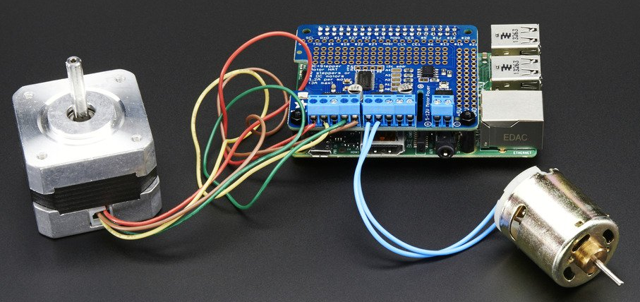
HAT and Shield Examples
Motor Controller
PWM/Servo
TFT Display, LED Matrix, eInk
Prototyping, Expansion shield
Check Pimoroni website for more HAT ideas
Notes:
https://learn.sparkfun.com/tutorials/arduino-shields

Slide 27
Lab 2: Sensor Example

Slide 28
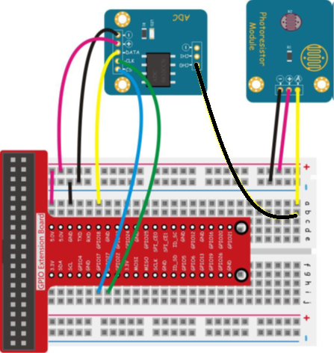
Lab 2: Measuring Light
Let’s use a photoresistor to read light levels
Photoresistor (analog) → ADC → RPi
Patch as in page 59 of the manual
CS 11
DATA 12
CLK 13
Don’t forget to patch 5V and GND to the
buses (the 2 small cables in the diagram)

Slide 29
Lab 2: Measuring Light
Open a terminal on your Raspberry Pi and run the following
sudo python photoresistor.py
You can get the ADC0832 module from here
https://github.com/sunfounder/Sunfounder_UltraKit_Python_Code_for_RaspberryPi/blob/master/ADC0832.py
wget https://goo.gl/vMNKCM
It gets downloaded with that name. Rename it: mv vMNKCM ADC0832.py
Cover the photoresistor. Can you see the readings change?
Any ideas?
Notes:
If you use the –O option with wget you can specify the name of the output file
wget -O ADC0832.py https://goo.gl/vMNKCM
This is the real repo from Adeept
https://github.com/adeept/Starter_Kit_Python_Code_for_RPi
You might have to tweak the pin definition in the ADC script

Slide 30
External Communications

Slide 31
External Communications
In most cases we need to get the data out of the edge
Need specific simpler protocols because of processing limitations of MCU
Easier on a SBC like Raspberry Pi
Many protocols
(Short-range) ZigBee (industrial), Zwave and Thread (home automation), BLE …
(Long-range, low power, low bandwidth) LoRaWAN, Sigfox, Neul …
Wifi, Cellular
Pull (Ex: Web server)
Push (Ex: Message Queuing like MQTT)
Notes:
https://www.rs-online.com/designspark/eleven-internet-of-things-iot-protocols-you-need-to-know-about
https://www.postscapes.com/internet-of-things-protocols/

Slide 32
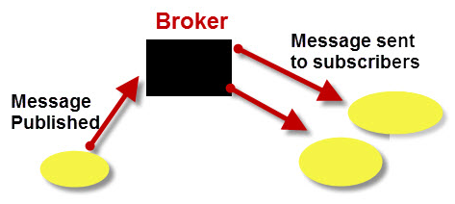
MQTT – Message Queuing for Telemetry Transport
Designed by Andy Stanford-Clark (IBM) and Arlen Nipper in 1999
The MQTT protocol enables a publish/subscribe messaging model
Very lightweight (small code footprint and small network bandwidth)
Mosquitto is an Open Source MQTT v3.1 broker
Clients connect to a broker and/or:
Subscribe to ‘topics’
Publish messages to ‘topics’
Topics are a hierarchy with “/” as separator, ex: meals/lunch/steak
Two wildcards: + (single level), # (all remaining levels)
a/b/c/d matches a/+/c/d and a/+/c/+
a/b/c/d matches a/# and a/b/#
Notes:
Andy Standford-Clark TED talk https://youtu.be/s9nrm8q5eGg
https://mosquitto.org
https://pypi.python.org/pypi/paho-mqtt/1.3.0
http://www.steves-internet-guide.com/client-objects-python-mqtt/
http://www.steves-internet-guide.com/mqtt-python-callbacks/
https://www.digitalocean.com/community/tutorials/how-to-install-and-secure-the-mosquitto-mqtt-messaging-broker-on-centos-7
http://www.hivemq.com/mqtt-essentials/

Slide 33
Lab 3: Flask Web Server

Slide 34
Lab 3: Flask Web Server in Raspberry Pi
For a small number of edge devices you can read values when required
Let’s make a web page with the thermistor readings … with Flask of course
Open a terminal to the Rasberry Pi and run:
sudo python photo-flask.py
Open a browser and point it to the IP of your Raspberry Pi
Move the sensor to change the readings and refresh the browser
QUESTION: How could you turn on the LED remotely?
Notes:
http://mattrichardson.com/Raspberry-Pi-Flask/index.html

Slide 35
Lab 4: MQTT

Slide 36
Lab 4: MQTT
This is the full end-to-end scenario
Photoresistor
RasPi
MQTT pub
Flask
Webpage
Mosquitto
Broker
Python
MQTT sub
Redis
LAPTOP

Slide 37
Lab 4: MQTT – VM steps
Use Vagrant to bring up the environment (use WIFI first, then tethering?)
vagrant up
Log in as “vagrant”. Verify Redis is running
ps –fe | grep –i redis
sudo service redis status
Verify Flask works and can read Redis. Verify with your browser
sudo python get-redis-value.py
Verify Mosquitto is running
ps -ef | grep -i mosquito
sudo service mosquitto status

Slide 38
Lab 4: MQTT – VM steps
Verify Mosquitto works – mosquito clients
Open 2 Putty terminals to the Vagrant VM. Run each line on one
mosquitto_sub -h 127.0.0.1 -t test
mosquitto_pub -h 127.0.0.1 -t test -m "Hello world"
Verify Mosquitto works with Python paho-mqtt library
sudo python mqtt-pub.py
Let’s get the receiver writing to Redis. Use 3 terminals. Verify on Browser
sudo python get-redis-value.py ← Flask web server to show values
sudo python mqtt-sub.py ← Puts message into Redis
sudo python mqtt-pub.py ← Publishes messages

Slide 39
Lab 4: MQTT – End-to-end
Transfer the photoresistor readings from the Raspberry Pi
Keep the “Flask” and “Sub” terminals open. Don’t need the “Pub” one
IMPORTANT: Disable McAfee firewall if tethering
Open a terminal in Raspberry Pi and verify MQTT is working:
mosquitto_pub -h your_laptop_IP -t test -m “The Pi says Hi!”
sudo python rpi-pub.py ← Edit the IP of your laptop first
Can you see the message in the “sub” terminal? If so, you can run
sudo python photo-pub.py ← Edit the IP of your laptop first
Refresh your browser. Does the value change?
Check out the diagram of the services you need running for end-to-end
Notes:
There are more and better examples on how to do stuff in the Paho official repo:
https://github.com/eclipse/paho.mqtt.python/tree/master/examples

Slide 40
Lab 4: MQTT – End-to-end
If the Vagrant install was successful you can just run “photo-pub.py” in RPi
Open 2 terminals for the VM and run “photo-sub.py” and “get-redis-value.py”
IMPORTANT: Don’t forget to enable your firewall again ☺
Rasberry Pi
photo-pub.py
Mosquitto
Service
Python
photo-sub.py
Flask
get-redis-value.py
Redis
Service
LAPTOP
Notes:
There are more and better examples on how to do stuff in the Paho official repo:
https://github.com/eclipse/paho.mqtt.python/tree/master/examples

Slide 41
From Prototype to Product

Slide 42
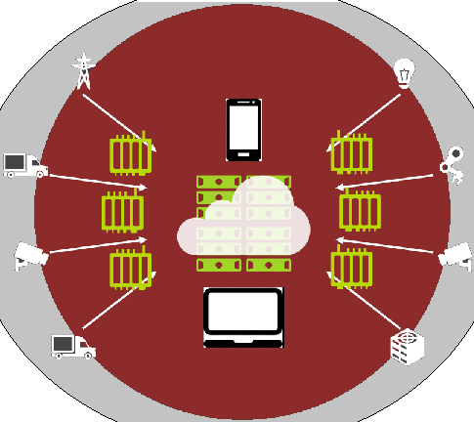

Considerations
Power
Relevant if the project needs mobility
Some MCU have power saving\, disable WiFi
Security
Much larger surface attach
Including physical security
PCB vs Cabling
Print commercially if multiple required
Or do it at home
Casing and assembly

Slide 43
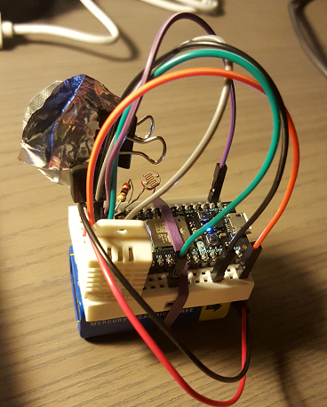
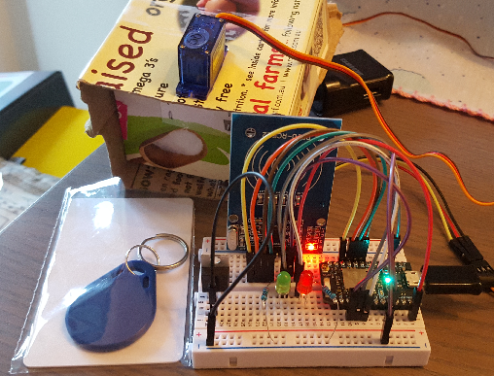
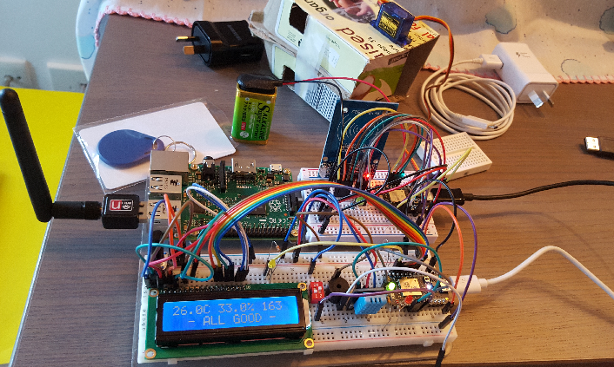
Challenges from Falcon-Eye Project
Unstable cabling, run out of ports
No power to run outdoors

Slide 44
Interesting Projects
Digital nose
https://hackaday.io/project/16809-electronic-nose-to-detect-fruit-ripening
Ardusat or high altitude balloon or rocket data logger
https://www.instructables.com/id/The-Ultimate-High-Altitude-Weather-Balloon-Data-Lo/
Duckietown (Autonomous cars by MIT)
http://duckietown.mit.edu/
Mini plotter, laser engraver, 3D printer from old DVD drives
https://www.instructables.com/id/How-to-Make-GRBL-CNC-V3-Shield-Based-Mini-CNC-Mach-1/
Self-balancing robot
https://www.instructables.com/id/Self-Balancing-Robot/
Automated farming
https://www.instructables.com/id/Automated-Greenhouse/
Notes:
http://duckietown.mit.edu/

Slide 45
Interesting Projects
NOAA Satellites or ISS signal receiver
https://www.instructables.com/id/HackerBoxes-0003-Amateur-Radio-Arduino-Nano-Satell/
Synthesizer
https://www.instructables.com/id/Auduino-Lo-Fi-Arduino-Synthesizer/
Seismometer
https://www.instructables.com/id/Slinky-Seismometer/
Smart mirror
https://hackaday.io/project/13466-raspberry-pi-smart-mirror
Home Automation
Robotic Arms (LittleArm, MeArm, …), rovers (line followers, obstacle avoidance, …)
Rubik cube solver
Notes:
http://duckietown.mit.edu/

Slide 46
Interesting Sites
Libelium
http://www.libelium.com/resources/top_50_iot_sensor_applications_ranking/
Instructables – Technology
http://www.instructables.com/tag/type-id/category-technology/
Hackster
https://www.hackster.io/projects?by=featured
Hackaday
https://hackaday.io/

Slide 47
Homework

Slide 48
Homework
Play with rest of the sensor kit
This is the link to Adeept’s repo for our kit
https://github.com/adeept/Starter_Kit_Python_Code_for_RPi
Or you can download the whole pack here including PDF, diagrams, etc
https://www.adrive.com/public/fG3Bf6/Adeept_Sensor_Kit_for_RPi.zip

